Slide 1

TEMPLATE

Slide 2

AWS Training

Slide 3
AWS Identity & Access Management
AWS KMS
AWS Secrets Manager

Slide 4
1. AWS Identity & Access Management
Users, Groups, Roles
IAM User
Service Role
Cross Account Role
Root User vs IAM User Vs Enterprise AD Federated Users
Policies
Customer Managed Vs AWS Managed Policy
Managed Policies Vs In-line Policy
Best Practices
Access Key Vs Role Based Access
use customer managed policies instead of inline policies.
Pricing ?
IAM is offered at no additional charge.

Slide 5
Lab 1
Create users (WebDev1, WebDev2, ETLDev1, ETLDev2)
Create Web Developers Group, ETLDevelopers Group and attach respective users to it.
Create WebDeveloperRole & ETLDeveloperRole.
Attach S3 Read only Policies to WebDeveloperRole & Lambda Invoke ETLDeveloperRole.
Grant Roles to the Respective Group.
Use the Role to Access the Services & Validate the response.

Slide 6
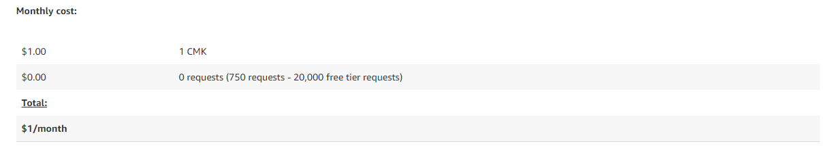
2. AWS KMS – Key Management Store
AWS KMS is fully managed service and makes it easy for you to create and manage cryptographic keys and control their use across a wide range of AWS services and in your applications.
Integrated with CloudTrail to record all the API Logs and Audit purposes.
You only pay US $1/month to store any key that you create.

Slide 7
Lab 2
Create a KMS Key and Use it to Encrypt a S3 Bucket.
Grant the Key Access to the ETL Developer Role & Access the S3 Bucket.
What happens When you to try Accessing the Bucket from Lambda using Web Developer Role ?

Slide 8
15 Minutes Break

Slide 9
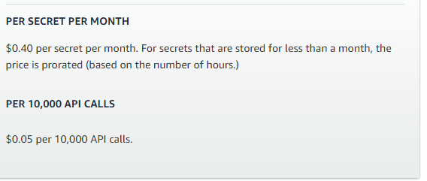
AWS Secrets Manager
AWS Secrets Manager helps you protect secrets needed to access your applications, services, and IT resources.
Use case:
Users and applications retrieve secrets with a call to Secrets Manager APIs, eliminating the need to hardcode sensitive
Programmatic retrieval of secrets & Audit and monitor secrets usage
Best Practices
Use a Cross-Account KMS Key to Encrypt the Secrets Stored
Automatic Secrets Rotation by Integrating with the Lambda's
Pricing

Slide 10
Lab 3
Describe the list of secrets available.
Create a New KMS Key – This will be used to encrypt/decrypt the secrets(Password).
Create a Secret and Encrypt it using the KMS Key.
Grant Access to the WebDeveloperRole to access the KMS Key Created in the above step.
Retrieve the secrets in the Lambda and use it in your application.
Practice
Can the ETL Developer Group access the Database secrets ? & Why ?
Create a Database Secrets and Grant Access to ETL Developer Group.

